Slide 1
Group 5: loss monitoring and logging
Craig, Toby, Pranav, Evelyn and Anton
RAL Visitor Centre
07.07.23

Slide 2
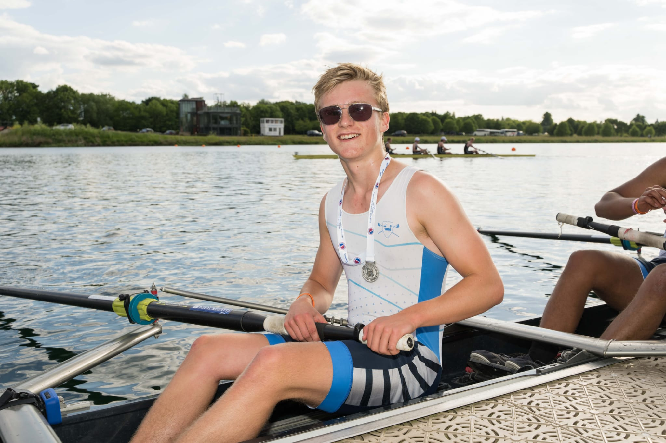
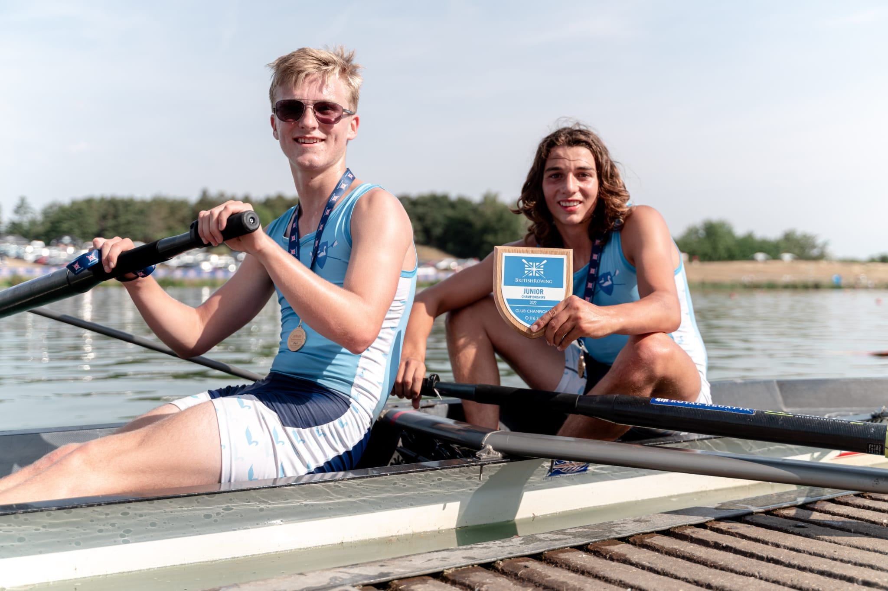
Anton
Among coding and game design I also do a lot of rowing, training 17 hours every week. Last year I won the Junior British rowing championship in the J16 pair and came second at the National schools regatta in the J16 coxed four, but haven’t won any important medals this year.
The work experience has been an amazing opportunity:
I’ve met loads of new people and got on well with them
I’ve learnt loads of new things about python such as matplotlib and pyqt
I’ve developed my problem solving and teamwork skills

Slide 3
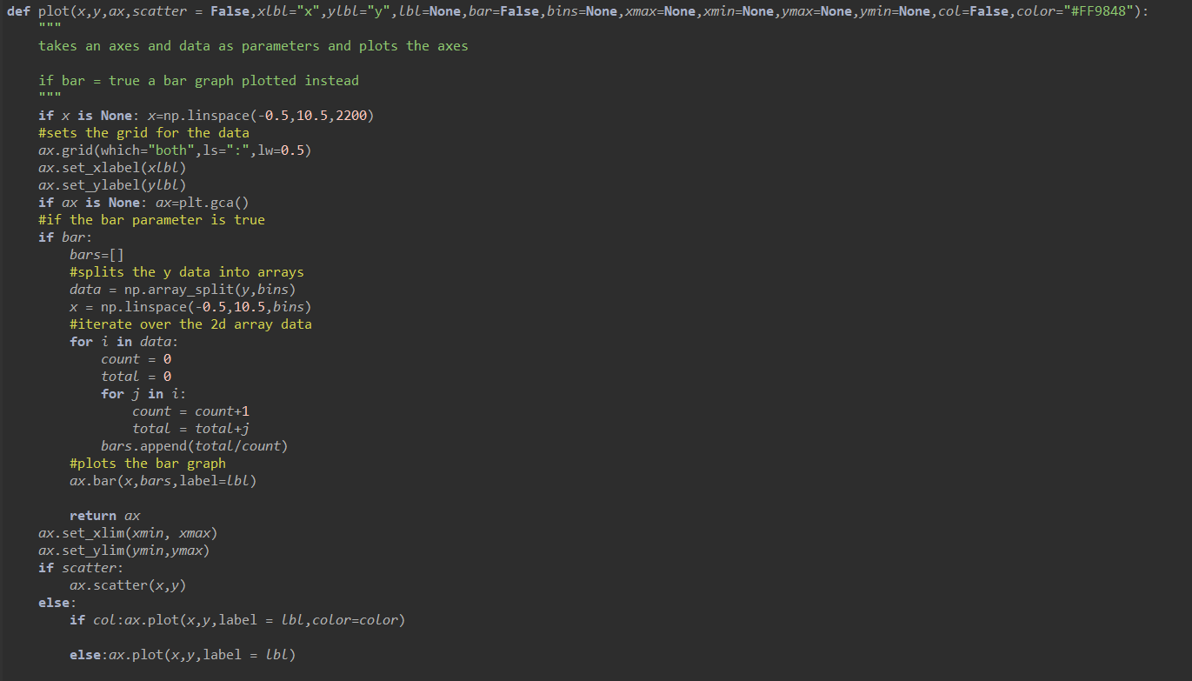
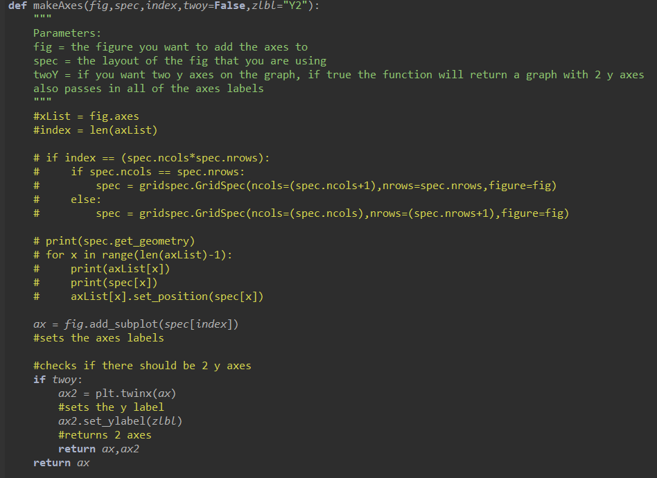
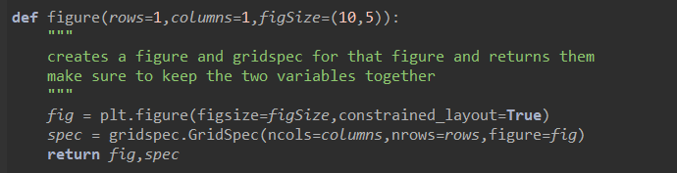
Stage 1 Projects: Group H: Plotting
In my team I coded the Figure(), makeAxes() and plot() functions. These were designed to make plotting in phase 2 a lot easier for everyone.
I had to learn a lot of matplotlib which was completely new to me, it also didn’t help that we had to restart on the third day as we miss-interpreted the project brief.

Slide 4
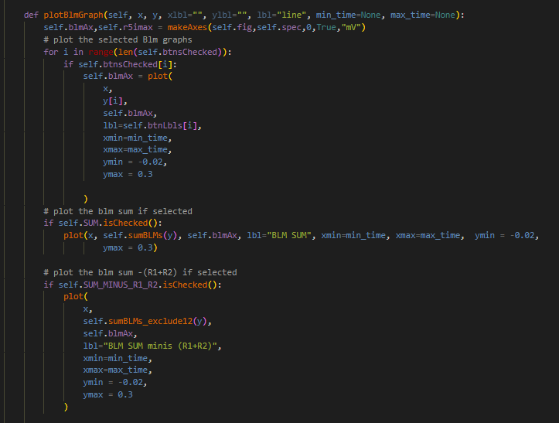
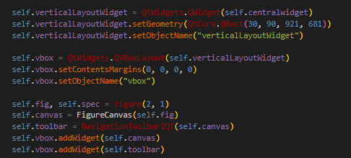
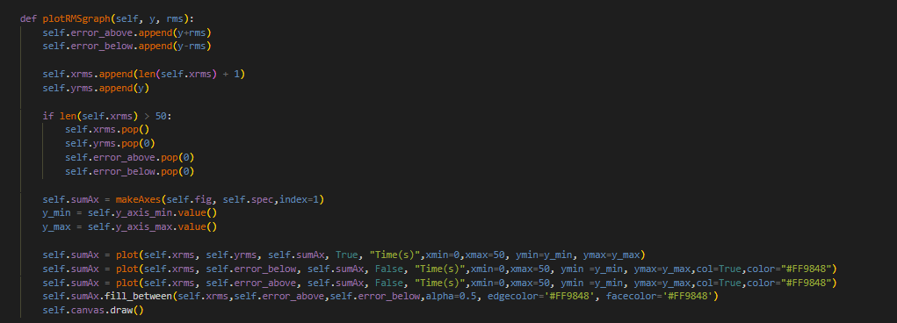
Stage 2 Projects: Loss monitoring and logging
At this stage of the project I continued with what I knew – plotting the graphs but this time in a GUI. I also helped with linking some of the buttons to their features on the graph.
I learnt a lot more about how pyqt worked and how to implement things inside of it.

